Slide 1
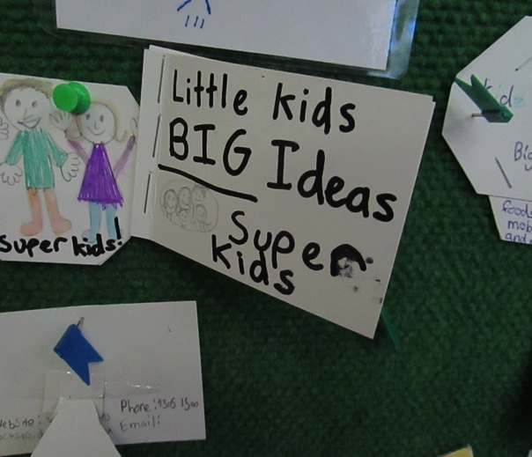
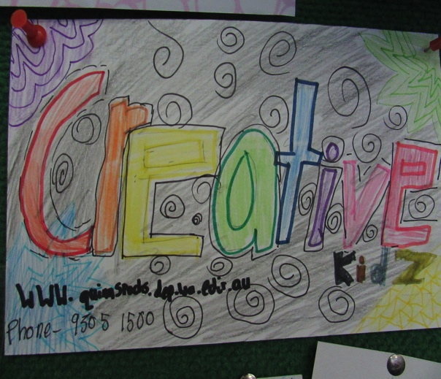
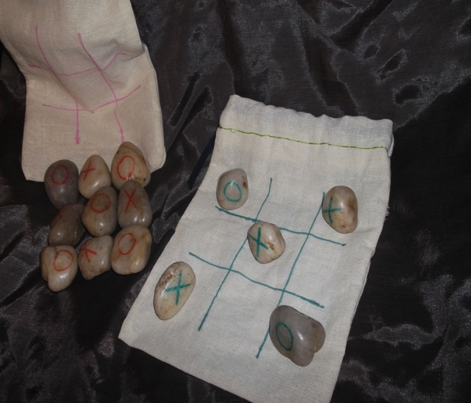
WELCOME TO ENTEPRISING KIDZ
QUINNS ROCKS PRIMARY SCHOOL
EDUCATION
INNOVATION
SUSTAINABILITY
LEARN BY DOING & BEING THE CHANGE WE WANT TO SEE IN THE WORLD!
BE CREATIVE & DARE TO THINK DIFFERENTLY!
CO-CREATE A JUST, MEANINGFUL & THRIVING WORLD FOR ALL LIFE ON EARTH!

Slide 4
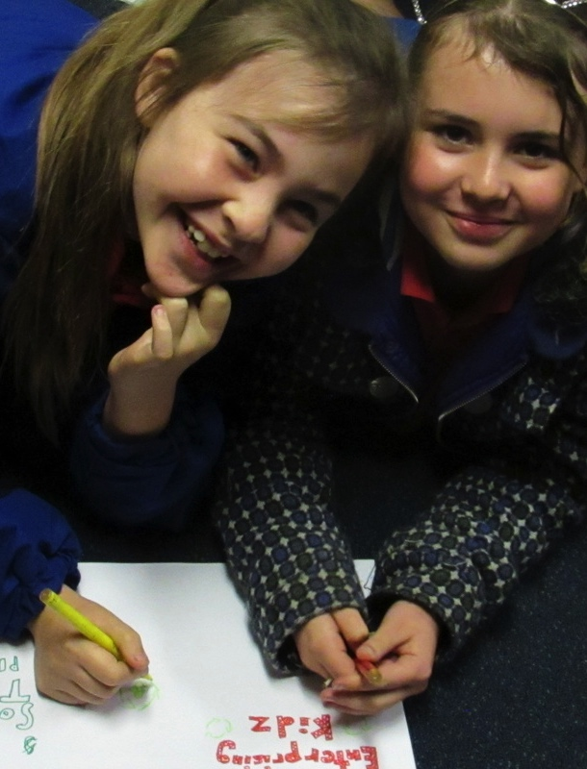
Adults always say that kids can’t make a difference because they’re a kid.
But this business proves that kids CAN make a
BIG! difference in the world!
WELCOME
I AM Isabella Pittard & WE ARE …

Slide 5
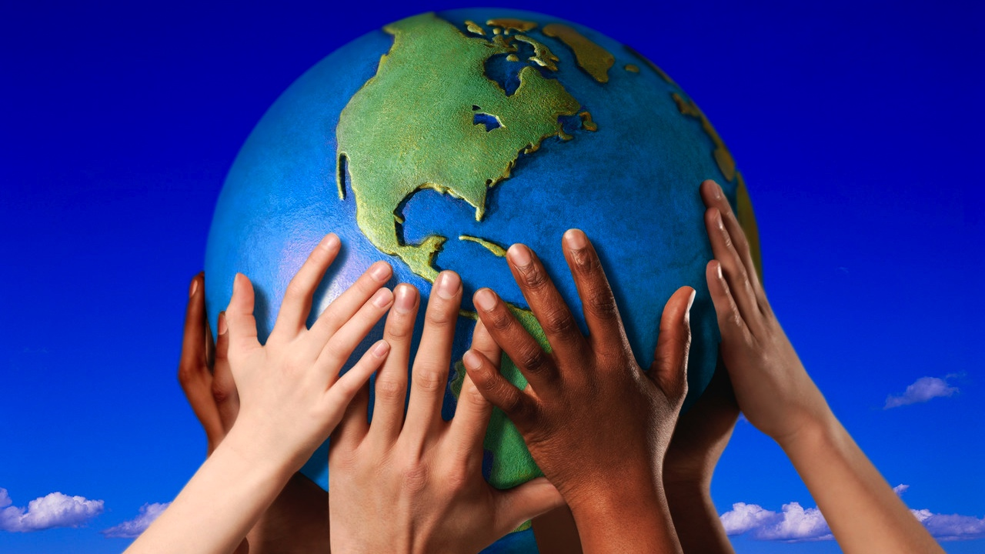
ENTERPISING KIDZ @ QUINNS ROCKS PRIMARY SCHOOL
SAVING THE PLANET ONE BIT AT A TIME!

Slide 6
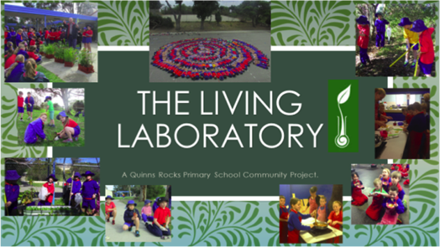
Quinns Rocks Primary School
INDEPENDENT PUBLIC SCHOOL
We have almost 400 students at our school; and get involved in lots of interesting school projects, which we’ve been awarded various grants and prizes for.
Being Sustainable
We all know it!
We all want to do it!
But how can we help?
Create an interactive environment that nurtures …
Mr David Fernandez
THE ONE WHO IS CHAMPIONING THESE PROJECTS
Mr David Fernandez has been instrumental in securing well over $20K of funding from local organisations (such as City of Wanneroo, Bunnings, The Waste Authority, Toyota) and in kind contributions (from parents and the local community) to help fund and action the sustainable school project at Quinns Rocks Primary School.

Slide 7






What is Enterprising Kidz?
We are 9-11 year olds from a year 4/5 class at Quinns Rocks Primary School; and we’re starting a BIG business.
Enterprising Kidz is a school program for kids that teaches us how to start a business, using 100% recycled materials to create new products, raise funds and save the planet from waste.

Slide 8
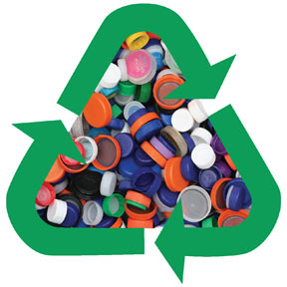

Saving the Planet One Bottle Top at a Time!
PICTURE THIS …
1000’s of Bottle Tops
You decide to throw out lots of bottle tops that normally would end up in the rubbish & landfill!
Big Idea!
But then, you remember: There’s a website that may want these bottle tops for recycling.
Go Online & Donate
So you go onto the website and donate your bottle tops.
Recycle & Save Planet
The bottle tops are recycled into new products to sell to customers in our local area.
Raise Funds for School
The money raised from the sale of the bottle tops will fund other school projects & programs.
Well Done!

Slide 9
Every business helps people solve problems like these. We created Enterprising Kidz, because we have identified two problems.
SOLVING PROBLEMs!
Problem #1: Waste
Problem #2: Funding
First, there is too much waste going into landfill. Why?
The toxic waste spreads and endangers all species. If we keep doing this, then it will affect more and more people and damage the environment beyond repair.
Our school is always challenged to get enough funds for the many activities it participates in.
So the profits from the products will raise funds for the school, while help to solve the environmental waste problem.

Slide 10
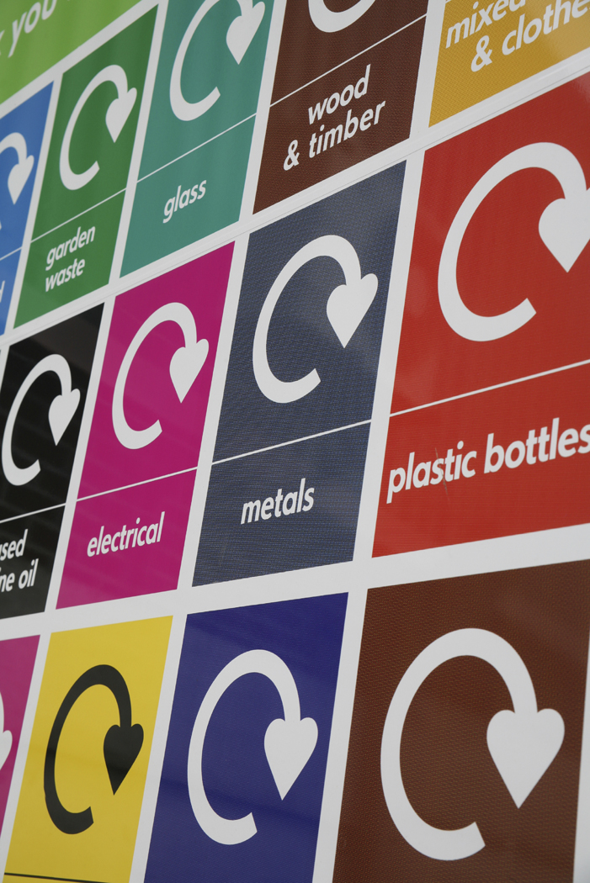
Why We Do It?
(Our Value Proposition)
We created Enterprising Kidz because we want to help stop waste polluting our world!
When waste goes everywhere it endangers all species and all life on the planet!
If we keep going the way we are, everything will die out.
That's why we created Enterprising Kidz, a business that’s:
Saving the Planet One Bit at a Time!
(by using 100% recycled products to raise funds for school projects)

Slide 11
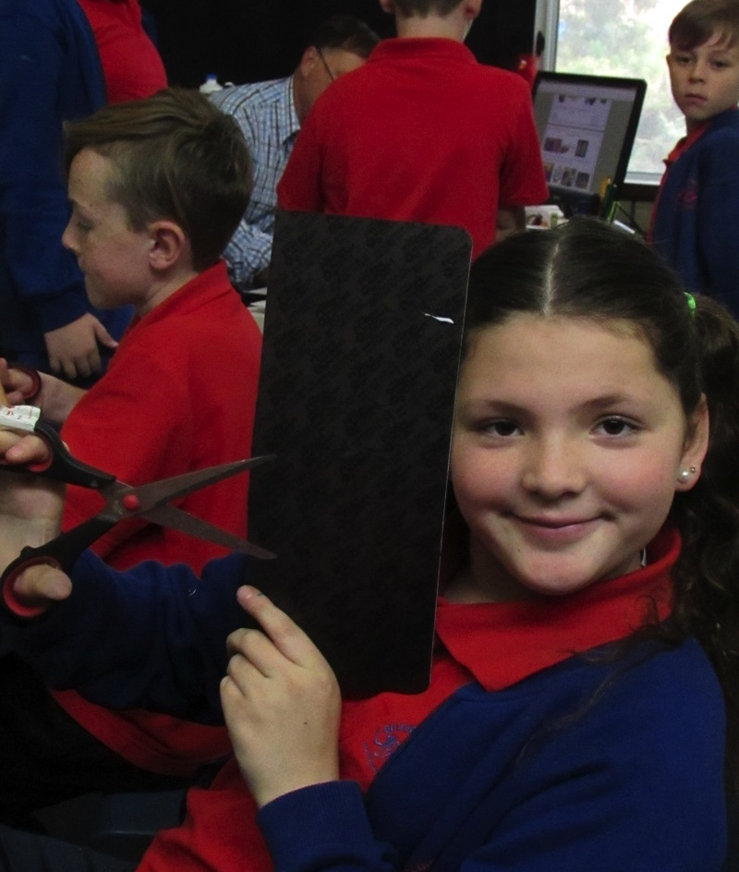
Enterprising Kidz started off as a new experience for our class to learn about how to start a business.
This is our learning journey …
HELLO!
I AM Carolanne Newman
I AM Hayden Malone
I AM Tori Newton

Slide 12
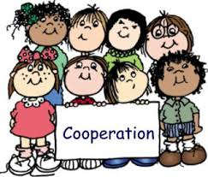

Starting a Business!
Enterprising Kidz started off as a new experience for our class to learn about how to start a business.
In February this year, area 6 had a visitor from Avant-Garde Leadership, her name was Vesna. She taught us all about how to create a business.
After a few weeks of lots of different activities, Vesna gave us a challenge:
find at least 5 things at home that we were going to throw-out and make (recycle/repurpose) them into products we could sell.
This meant our business would help the environment and the community, while raising funds for the school.
By the end of the year, we learnt that creating a business is not as easy as it seems, it takes a lot of time, effort and collaboration from everyone involved.

Slide 13
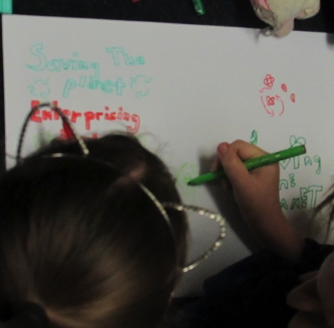
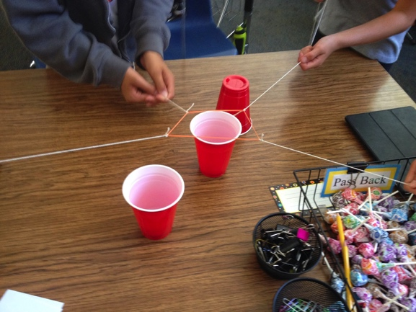
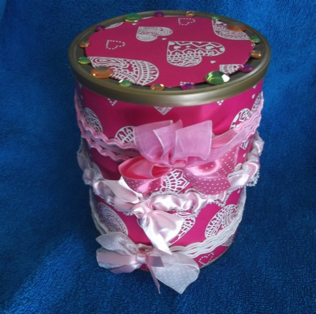
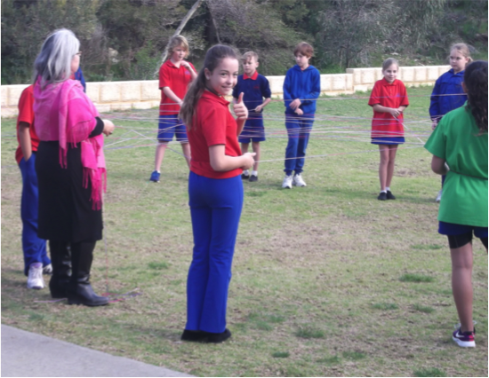
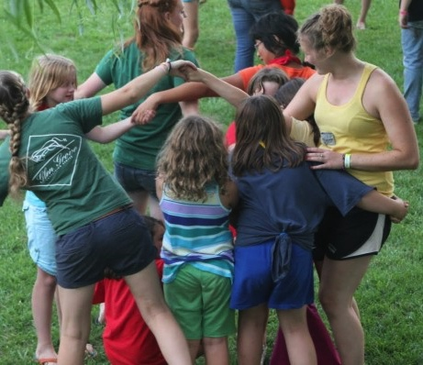
Lessons Learnt (learning by doing & being)
(February – December 2016)
Activity 1:
Mythical Creature
Activity 2:
The Tower Game
PURPOSE: To learn about the different personalities in the class
OUTCOME: We learnt a little bit more about each other (we were a new class); we learnt how we were all different and the same in many ways)
PURPOSE: To learn how to work together and collaborate.
OUTCOME: We learnt a little bit more about each other (we were a new class); we learnt how we were all different and the same in many ways)
Activity 3:
A Ball of String
Activity 4:
The Human Knott
Activity 5:
The Challenge
PURPOSE: To learn how the internet is a global network
OUTCOME: With a ball of wool, we were able to create a network within a circle to represent how the internet can reach everyone
PURPOSE: To learn how to solve problems together
OUTCOME: We learnt there was always a way to solve a challenge, if we collaborated and worked together to find a solution
PURPOSE: To learn how to create recycle products for sale
OUTCOME: We were given the challenge to bring in at least 5 items from home that were to be thrown out, which we had to repurpose into sellable products

Slide 14
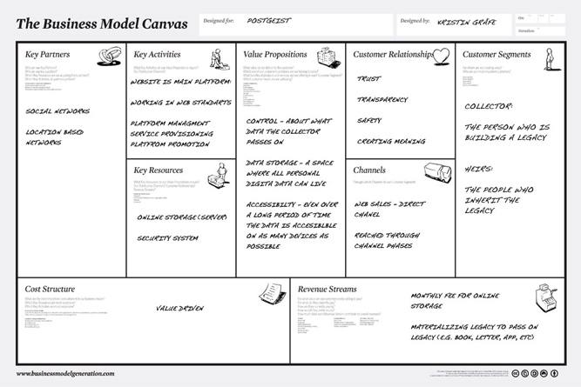
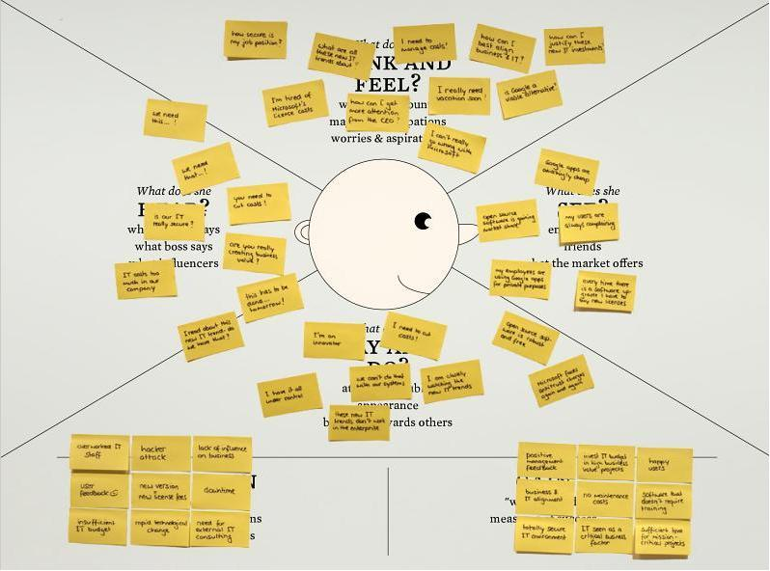
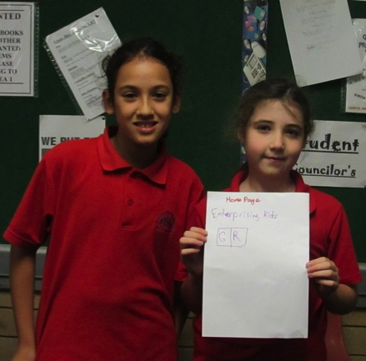
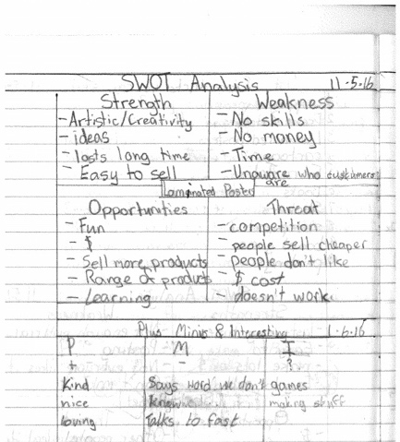
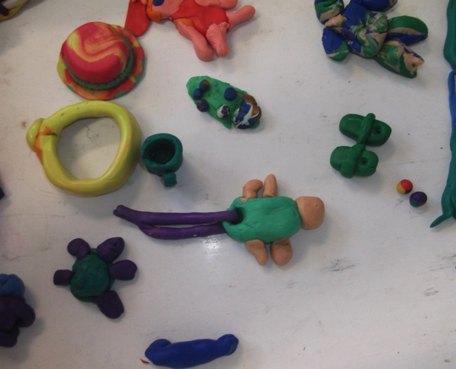
Lessons Learnt (learning by doing & being)
(From February – December 2016)
Activity 6:
Business Model Canvas
Activity 7:
Empathy Map
PURPOSE: To learn all elements need to create a business
OUTCOME: We learnt about the Value Propositions, Customers, Distribution Channels, Key Activities, Resources, Costs Revenue etc., of our business.
PURPOSE: To learn about why our customer will want to buy from us
OUTCOME: We discovered how we could help the solve the problem of reducing waste from landfill, by recycling old products into new, to sell and raise money for the school
Activity 8:
SWOT Analysis
Activity 9:
Prototyping
Activity 10:
The Pitch!
PURPOSE: To learn about the importance of a SWOT Analysis OUTCOME: We learnt a lot about all the Strengths/Weaknesses; and Opportunities/Threats of our business.
PURPOSE: We learnt to create products and marketing material OUTCOME: We created sample prototypes of our products, business cards, flyers / posters, website and app.
PURPOSE: To learn how to pitch a business to different people
OUTCOME: A group of us got to practice how to present and pitch our business to strangers; it was great experience, we learnt a lot and gained more confidence

Slide 15
Keeping a Blog & Newsletter
The Blog and Newsletter are a great way to communicate with current and potential new customers, as a way to build a profile and trusted brand
When we started making products we then started posting pic ’s of the items onto our web page to create a presence.
Students started a blog, some students wrote newsletters.
The blog recorded all the activities that we did over the weeks from start, to production and this final presentation!

Slide 16
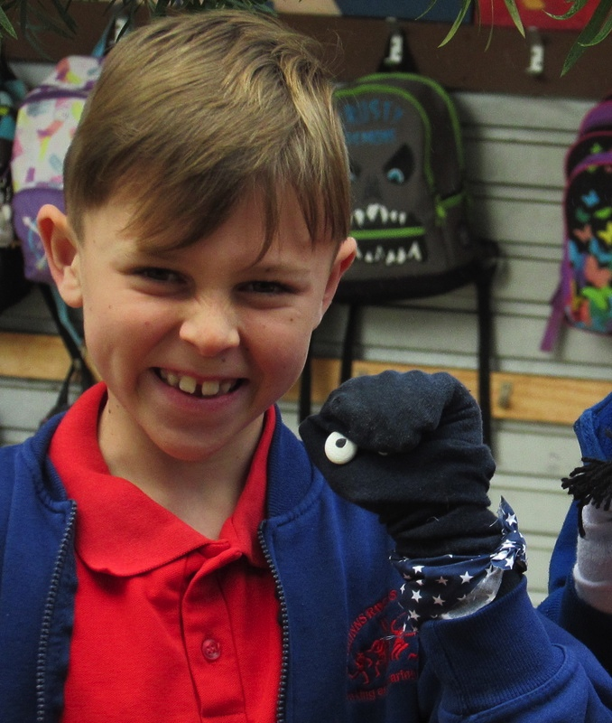
“Market research is important so that you know that your products are going to sell”.
WELCOME
I AM Jasmin Goodridge …

Slide 17
Why is Market Research important?
Market research is important so that you know that your products are going to sell.
The data that I am going to show you is only the results of just some of our products, we didn’t have the time of day to do all of our products.
One of the products was also donated by a parent.

Slide 18
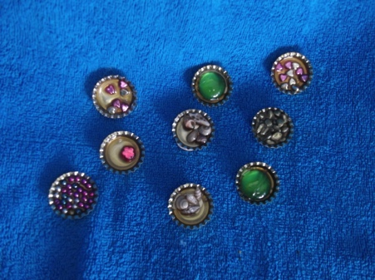

Slide 19
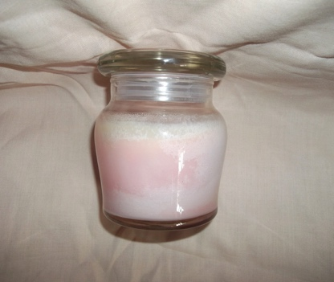

Slide 20
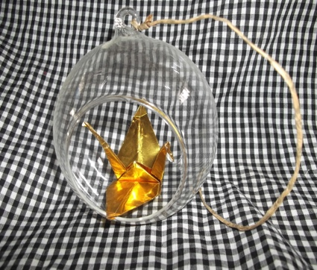

Slide 21
Summary
In summary if you were to sell these products you would sell the:
Admin staff the Quinns Caps
Girls everything
Boys the Quinns Caps
Teachers the Ornaments.
So that is the end of my presentation now I am going to hand it over to Jake & Abbie.

Slide 22
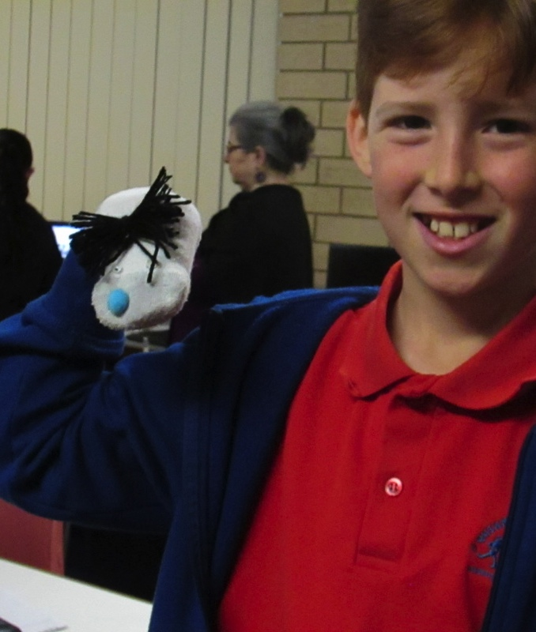
“Customer service is all about how you serve your customer and how you make them feel about your product & service”.
WELCOME
I AM Abbie Barnes &
I AM Jake Webber ...

Slide 23
Enterprising Kidz
Enterprising Kidz is all about “saving the planet a little bit at a time” and we do this by the 5R’s (reduce, reuse, recycle, relearn and reward).
Some adults think WOW! they’re just kids, they won’t be able to create an online business like us adults, but we really can. We make products from 100% recycled materials, to reduce waste from going to to landfill.
Now that we have explained what our online business is about, let us tell you what we’ll be talking about today, which is ….
Customer Segments & Customer Relationship

Slide 24

Customer Service!
Customer service is all about how you serve your customer and how you make them feel about your product & service.
It is always good to have great customer service because when you show people how you can help them and give them advice as part of your business they will want to buy your products and will most likely come back again.
Our customers are, our:
Family & Friends
local community; and maybe even
People around the world (as we have an online business)

Slide 25

Customer Relationships
Customer relationship is the relationship you build with your customers and the benefits you offer through your products & services.
When you show great customer service like being polite helping them find products, giving them advice on your products.
When you do this you build up a good relationship with you customers, when you have a good relationship with your customers they will come back and buy more products from you and they will tell their family and friends about your business and then you get more customers

Slide 26
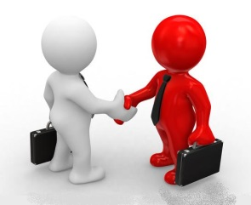
Why Customers Want To Buy From Us
The benefits of buying products & services from us:
100% recycled products
Reducing waste from landfill
Recycling them into products
Giving back to the community
Raise funds for the school
It is all run by kids and thought of kids
Kids are great at thinking outside the box
We’re crowdfunding from our local community
Helping people to help other people

Slide 27

Don’t Forget to Recycle!
Remember:
Always use the 5rs
Never throw out things that could be reused
Remember to use life hacks
Always think if you can make a toy or a product from us

Slide 28
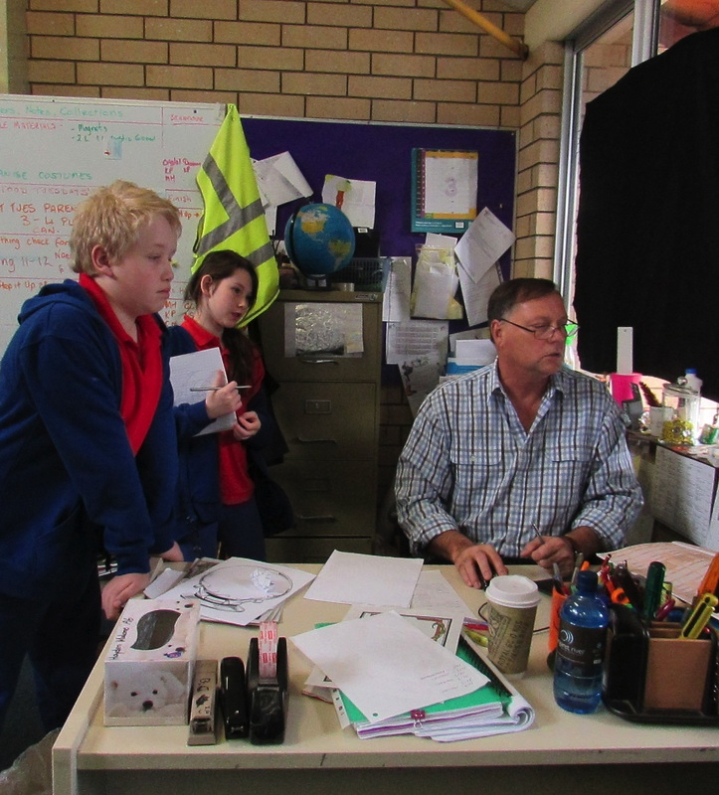
“Distribution Channels are all about the ways we are going to reach our customers to deliver our service and/or products”
WELCOME
I AM Tom Copping &
I AM Archie Kelly ...

Slide 29
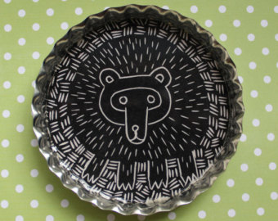
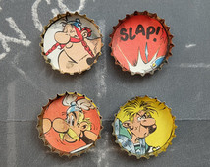
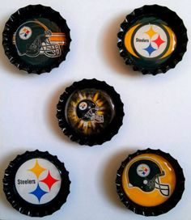
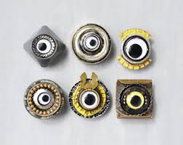
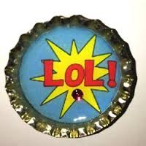
What are Distribution Channels?
Distribution Channels provide the answers to:
*How to find us
*Where to find us
*When to order
*What to order
*How to order
*How to get products faster
*What our email is
*What our details are

Slide 30


Distribution Channels
HOW WE REACH OUR CUSTOMERS
Some of the distribution channels you may be able to find us at are:
Facebook
Twitter
Website
App
You can use social media, like a website, to better engage with your customers more often
A Twitter account has been set-up for Quinns Rocks Primary School
http://enterprisingkidz.weebly.com/store/c1/Featured_Products.html,
An App allows customers to easily access information and engage with your
Please visit us on any one or more of our distribution channels.
Also feel free to order some of our products from our website
Go to the following link http://enterprisingkidz.weebly.com/our-products.html

Slide 31

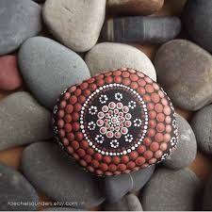
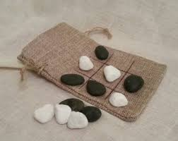
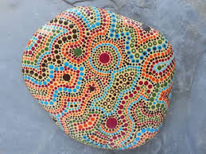
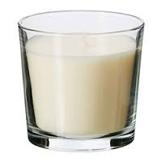
Our Products
Some of our products are:
Scented candles
Quinns caps [fridge magnets]
Money jars covered in loom bands
Travel noughts and crosses
Aboriginal painted rocks
You can go on to our website and add things that you don’t need anymore but it cant be rude. And that will help us a lot.

Slide 32


The benefits of an App

One central portal
Easy to Access
Engagement
An App lets you reach all your distribution channels from one device (i.e., Mobile Phone and/or Tablet)
These days most people always have a device with them (like a phone or tablet) wherever they are.
An App lets you engage with your customers in many ways; you can even gamify their experience
App Development
Community2Go with Brendan Wright
We’ve also started to make an app. A man named Brendan came in to talk to us about how to make an app. Brendan told us some very interesting things about apps and why they’re important.

Slide 33

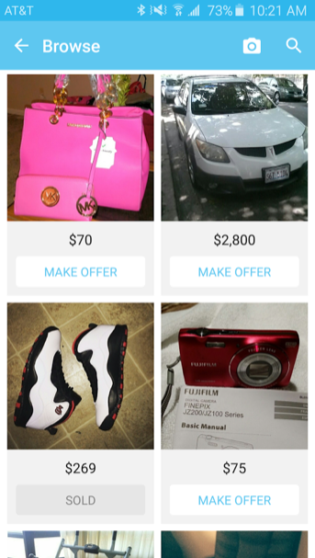



Our App features
THE VALUE OF AN APP
SWAP / BUY & SELL GOODS
Using the app you will be able to swap, buy and/or sell products that could have been thrown out or ended up on landfill
COMMUICATION WITHIN SCHOOL COMMUNITY
Allows you to post new products, services, news and information all via one simple device, to communicate with your customers
WEBSITE AT YOUR FINGERTIPS
◆
Ease of access to our website
GAMIFCIATION
Create a game to engage with our customers more often; to play for fun, learn and be rewarded for being sustainable
SOCIAL MEDIA CONNECTIONS
The app will allow you to connect with our Enterprising Kids program via our pages on different social media platforms

Slide 34
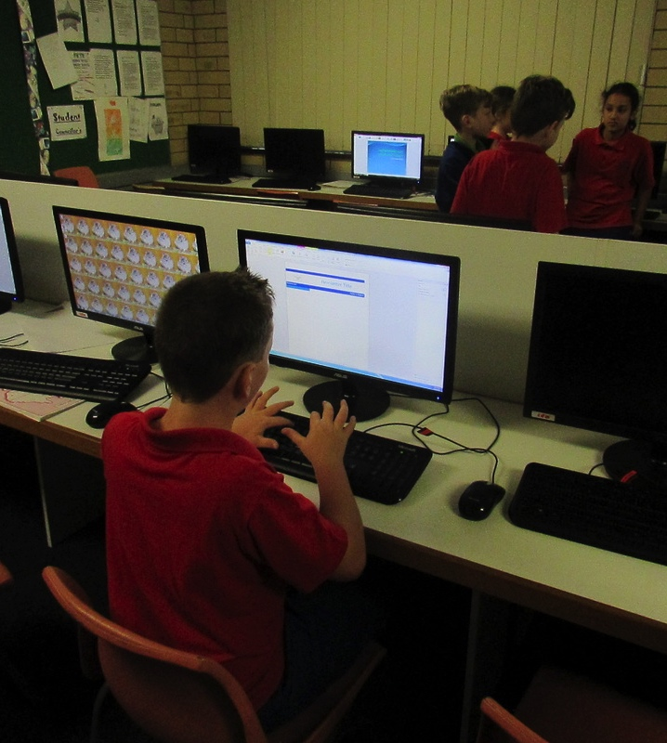
“Gamification can act as a great engagement tool to inform, teach and entertain your customers; by building trust and inspire them to buy your products and services”
Let’s introduce our game!
WE ARE Flynn, Jay & Sonny

Slide 35
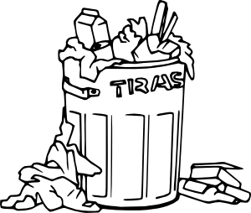
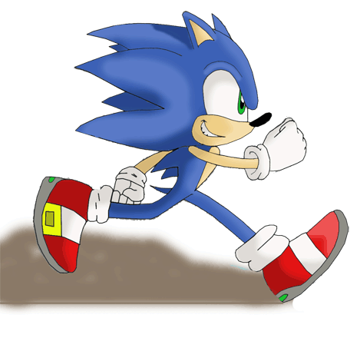

Trash Run!
A game that saves the world a little bit at a time

Slide 36
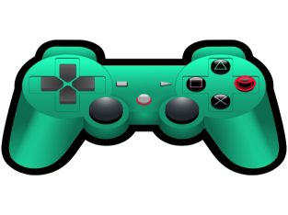
What our game is about
Some key points:
Our game is teaching young children to save the planet, a little bit at a time.
But if you are worried, it really isn't that hard.
I know what your thinking, what these kids are trying to do they can’t be successful. Well you’re wrong!
My school has created an Enterprising KidZ website and its popularity is shooting through the roof, that's what our game is about

Slide 37

How to play
Some basic rules:
Get your first character which is Fred the delivery boy which is free.
You start of with one thousand coins and one thousand jems.
You earn coins wen you collect a piece of trash, when you go around your city.
Now I noticed that the sea wasn’t clean either so I added an under water map to keep our sea wildlife from being harmed

Slide 38
Problems with our society today
Final message:
I'm a kid and even now I see what is wrong with our society. I walk around my community and all I ever see is trash and I'm sick of it. I want to make a change to our planet so the next generation of kids can do what we can do now.
The next time you see a piece of trash, do your part and put it in the bin; like when I walk to school and I see a piece of trash I pick it up and put it in the bin.
All these kids here today are creative and do arts and craft with all the stuff that you donate and it be used for my school to play a massive part in recycling this year and I'm hopping you can too!

Slide 39
2017 Goals
OUR GOALS FOR 2017
1. Continue in 2017
We aim to continue the program with next years students and we will officially launch Feb / Mar 2017 (incorporating all the learnings so far).
2. Create the App & Game
We first need to find out some legal and technical requirements to be considered, while we work on the design and then move into full product production. We’re equally keen for families to donate goods
3. Begin Community Swap-meet
Next year we aim to add to the website and especially the App a Community Swap function (where families will be able to swap goods of equal value as a way to save money).

Slide 40
Any Questions?

