Slide 1
VAQ
By Mr F

Slide 2
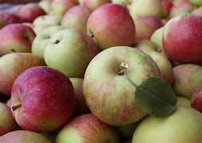
Value Adding Quest
By
John Smith
Year 4
2022

Slide 3
Contents
Slide 1-100 Primary Products.
Slide 2 -VAQ meaning and Primary Product meaning.
Slide 3-Survey.
Slides 4-10 What I am doing.
Slide 11 Business card

Slide 4
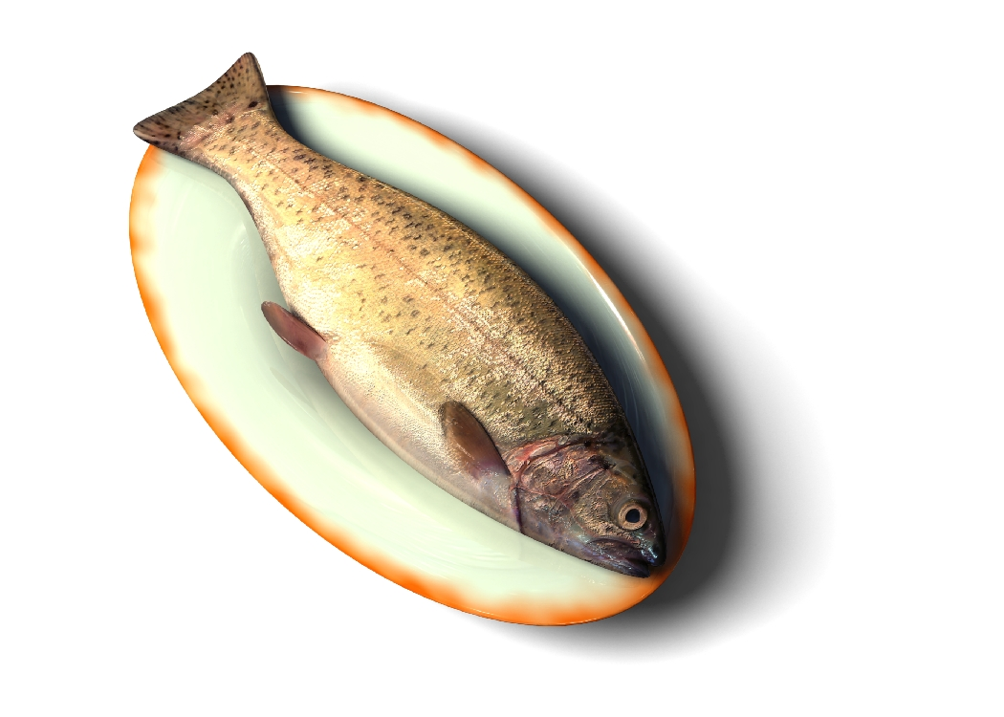
Apple | Pear | Banana | Peach | Orange
Broccoli | Mango | Coconut | Wheat | Rosemary
Oil | Gold | Silver | Radish | Pumpkin
Corn | Peas | Baby potato | Baby corn | Snow peas
Iron | Aluminium | Diamonds | Ruby | Sapphire
Pearl | Topaz | Emerald | Wood | Mineral salts
Water | Potato | Tomato | Carrot | Rose
Sugar cane | Lemon grass | Milk | Eggs | Crab
Steak | Bacon | Pork | Tulip | Violets
Sun flower | Daffodil | Daisies | Lemons | Pickles
Sea cucumber | Squid | Sardine | Beetroot | Poi
Beans | Blueberries | Raspberries | Chinese apples | Grapes
Sour grass | Rabbit | Dolphin | Strawberries | Mint leaves
Tea | Ginger | Coffee beans | Hazelnut | Peanuts
Cashews | Rice | Elephant | Snake | crocodile
Blackberries | Stone | Cucumber | Frangipanis | Honey
Honey ants | Cotton | Fur | Cheetah | Shark
Salmon | Lavender | Cumin | Trees | Tuna
Lettuce | Cinnamon | Trout | Grains | Goat
Paprika | Plum | Nectarine | Ham | Octopus
Apple | Pear | Banana | Peach | Orange
Broccoli | Mango | Coconut | Wheat | Rosemary
Oil | Gold | Silver | Radish | Pumpkin
Corn | Peas | Baby beansd | Baby corn | Snow peas
Iron | Aluminium | Diamonds | Ruby | sandfyre
Pearl | Topaz | Emerald | Wood | paepper
Water | Potato | Tomato | Carrot | Rose
Sugar cane | Lemon grass | Milk | Eggs | Crab
Steak | Bacon | Pork | Tulip | Violets
Sun flower | Daffodil | Daisies | Lemons | Pickles
Sea cucumber | Squid | Sardine | Beetroot | Poi
Beans | Blueberries | Raspberries | Chinese apples | Grapes
Sour grass | Rabbit | Dolphin | Strawberries | Mint leaves
Tea | Ginger | Coffee beans | Hazelnut | Peanuts
Cashews | Rice | Elephant | Snake | Alligator
Blackberries | Stone | Cucumber | Frangipanis | Honey
Honey ants | Cotton | Fur | Cheetah | Shark
Salmon | Lavender | Cumin | Trees | Tuna
Lettuce | Cinnamon | Trout | Grains | Goat
Paprika | Plum | Nectarine | Ham | Octopus
100 Primary Products

Slide 5
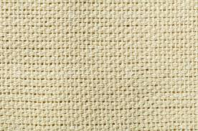
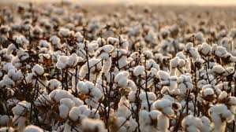
Primary Product Meaning
A primary product is something that is in its raw and natural state. It can be grown, harvested dug out of the ground, farmed. Like, fruit, vegetables, flowers, herbs, minerals, wool, cotton, seafood and meats.
Value Adding Meaning
Doing something or change the primary product to make more money. Raw Cotton to cotton fabric

Slide 6
Survey

Slide 7
https://www.youtube.com/watch?v=T4IDl0ywnIs

Slide 8
I will be value adding STRAWBERRIES
Save as primary product What will you do 2012, border it.
Aim:
Chocolate covered strawberries make an easy and elegant candy dessert. You can substitute white or milk chocolate for semi-sweet, or experiment with double-dipping the strawberries in different chocolates to vary the flavor and appearance.
Be sure to check out the video showing how to make chocolate covered strawberries!
Utensils sieve, toothpicks, bowl, spoon
Prep Time: 10 minutes
Total Time: 10 minutes

Slide 9
Ingredients:
1 dozen ripe strawberries
1 cup chopped chocolate (preferable) or good-quality chocolate chips
Preparation:
Prepare a baking sheet by lining it with aluminum foil.
Wash the strawberries and dry them thoroughly.
Place the chocolate in a microwave-safe bowl and microwave until it is melted, stirring after every 30 seconds. Overheated chocolate gets thick and hard to work with, so it's important to keep a careful eye on the chocolate. Remove it when some pieces are still not melted, and stir until they melt. If you are using low-quality chocolate chips, you might need to add a little vegetable shortening to thin it out and make it easy to work with.

Slide 10
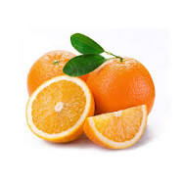
Coby’s Marvelous Orange Juice
 | 12 Orange way Quinns Rocks 6030 Coby.whitehead@student.wa.edu.au www.cobyorange.com.au

